Slide 1
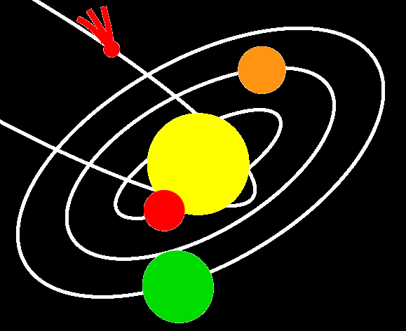




How to Write a Scientific Paper
Sami K. Solanki
Max Planck Institute for Solar System Research

Slide 2
Table of contents
Some basics
Before starting to write
Structure of a paper
  Title + Authors and affiliations + Abstract
  Introduction
  Methods and materials
  Results, including figures + tables
  Discussion and conclusions
  Acknowledgements + References + Appendices (online material)
After finishing to write
Style
Language
Refereeing process
PhD theses

Slide 3
Some Basics
Scientific progress has been the basis of much of the improvement in our standard of living and quality of life.
Science has also provided answers to a row of long-standing and deep questions (and many, many not so long-standing and not so deep questions as well).
What makes science so strong?
  Independence and freedom of research (only within limits for PhD students and post docs)
  Open communication of methods, results, data, etc. ➔ conferences, seminars, publications
  Peer review (refereeing) and critical discussion of results
  Repeatability of work and compatibility with other results
  Honesty (no plagiarism, make sure you have made no mistakes, avoid fooling yourself, only publish what you really have found)
Notes:
Standard and quality of living: Think of medicine and the war against disease; or all the little and big helpers that make work easier (machines of all kinds); or all the ways in which we are entertained now; or the many changes in society that have been caused by science (for the better or worse), including the freedom to choose our profession (from a very wide choice).

Slide 4
Some more Basics
One (maybe the most) important difference between academic & industrial or military research is making your methods and results public
  Publication means that results can be openly discussed, tested and compared (Pt. 2 is prerequisite for Pts. 3+4 in previous slide)
  ↓The checks and balances of science require publication.
  In the real world: Secrecy is often maintained (regarding ideas, techniques, or new results) until published
We must publish our results, even if we don’t like to write. Many famous scientists also didn’t like to write. E.g. Darwin, who once wrote: “A naturalist’s life would be a happy one if he had only to observe and never to write.”

Slide 5
Before starting to write
Each paper must provide new, non-trivial knowledge, insight
Write the paper only when you have final or near-final results
Keep a written record of your work as you do it, to avoid forgetting what you have done. After 3 months I have generally forgotten the details of what I did
➔ start writing a paper soon after getting your final results – do not wait too long; or others may scoop you
Leave yourself enough time to write: Even if you have “final” results, you will often realise you need to redo some work, or do some more work once you start to write
Discuss with your supervisor. He/she can judge best the time to start writing up

Slide 6
Before starting to write
Think early about what you want to communicate
Identify the main aim & message of your paper:
  All authors need to agree what will be the main message of the paper. Discuss with your supervisor and/or co-authors
  Papers with a single, clear message are the easiest to read and to remember
  If there are too many equally important messages, then the paper can become difficult to digest for the reader
  If you have many important results you may want to write multiple papers. However, do avoid MPU papers (MPU = Minimal Publishable Unit). Each will give you an additional paper, but will also give you a poor reputation

Slide 7
Before starting to write: Journal
Choosing a journal early: tips are provided towards end of lecture
After choosing a journal, carefully read its instructions to authors and follow them closely when writing! This will save you trouble later on
Follow the links on the following slide to find the author instructions to some popular journals – for other journals search for: <journal name> “author instructions”
You may even want to use the journal’s style file for your notes (or your reports to your supervisor). This will help you to learn and practice LaTeX as well as getting used to the style file of the journal

Slide 8
Instructions to authors from various journals
Astron. & Astrophys:
http://www.aanda.org/author-information/latex-issues/references
AAS journals, e.g. Astrophys. J., Astron. J.
http://journals.aas.org/authors/manuscript.html
Springer journals, e.g. Solar Phys. (similar for Space Sci. Rev., Earth Moon Planets, etc.)
http://www.springer.com/physics?SGWID=0-10100-6-794013-0
AGU journals, e.g. J. Geophys. Res., Geophys. Res. Lett.
http://publications.agu.org/author-resource-center/
Monthly Notices Royal Astron. Soc.
http://www.oxfordjournals.org/our_journals/mnras/for_authors/
APS journals, e.g. Phys. Review, Phys. Rev. Lett.
https://journals.aps.org/author-information

Slide 9
Before starting to write: read
Read the literature! This is important for 2 reasons
1. To learn how to write scientific texts
  You will find out how professional scientists write. Learn from their style and language (the language of science is not the same as everyday language) ➔ Riccardo Giacconi (Nobel prize in physics 2002) has his own definition of the “language of science”
  Best for this purpose is to choose papers by experienced native English speakers. Ask your supervisor to give you papers by a colleague who writes particularly clearly
  Write the notes of your work in a style appropriate for a research paper. Your writing skills will improve with time
Notes:
Riccardo Giacconi used to say in a broad Italian accent: “we all speak the language of science, broken English”

Slide 10
Before starting to write: read
Read the literature!
2. To identify what is new about your work compared to what has already been published & to better interpret your results
  Your work must be embedded in what has been done before: each paper is part of the ongoing story of science
  I.e. you must first know what else has been done and what hasn’t been done. You will put this into the introduction, but it is best if you know it even before you start writing the paper
  ➔You need to read the literature. This is something YOU must do. Don’t expect your supervisor to do it for you

Slide 11
Before starting to write: Structure
Put together the structure of the paper.
A generic structure is:
  Title, authors, affiliations, possibly key words, etc.
  Abstract
  1. Introduction
  2. Methods & Materials
  3. Results and
  4. Discussion & Conclusions
  Acknowledgements (optional, but most papers have them)
  References
  Appendices, online material (optional)
IMRaD is a typical structure (more complete: AIMRaDAR). In some cases (e.g. review papers, short papers in conference proceedings) other structures may be more appropriate

Slide 12
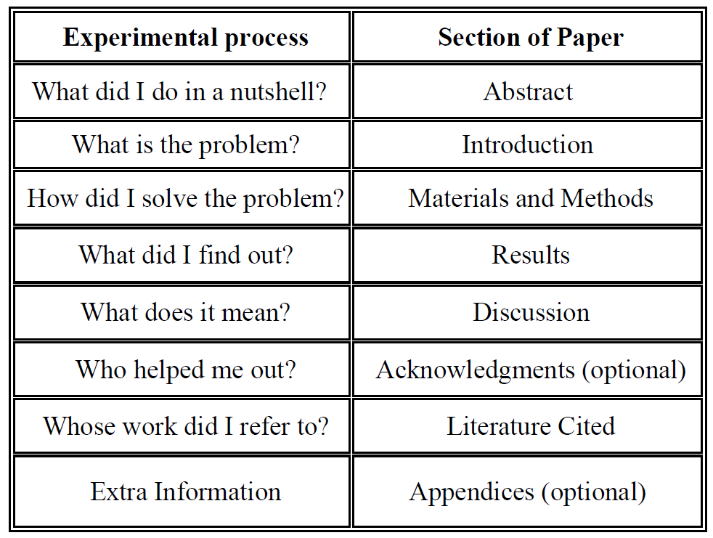
Before starting to write: Structure
What do these sections mean?
Why?
How?
What?
So what?
© Dept. Biology, Bates College, Lewiston

Slide 13
Before starting to write: Structure
The structure given in previous slides(s) is only a guide, but a pretty widely used and well-tested one. You can deviate from it, but do so only if there is a good reason
You can also add more structure ➔ you can divide long sections (e.g. Results) into subsections
Once you have a basic structure, you may want to make a list of things that you would like to put into each section.
Very important: Decide early on the main aim of the paper and on the main conclusion. What question should it answer? What has the scientific community learnt from your work?

Slide 14
Before starting to write: Selection
Select which results to show: start with the main results
  Often helpful: first choose the figures to be published
  Criteria: Does the figure show something significant & new? Is the figure important for understanding technique or results?
  Remember: your interest in the details of your work is larger than that of the reader ➔ be selective!
  Also remember: your knowledge of what you have done is larger than the reader’s ➔ Be sure you include everything needed to explain to the reader what you have done!
  Write at a level for another PhD student working in same general field (but not doing exactly the same as you)
  Talk with your supervisor and/or other co-authors at this point. Authors should agree on what to show/not to show in the paper

Slide 15
The Title
The title often decides if the paper is looked at by colleagues: So many papers, so little time!
  I first check the title (& authors). If interesting I look at the abstract, then possibly at the figures. Only then, and only if the paper looks particularly interesting will I read the rest
  The more attractive the title, the more likely your paper will be noticed
  Some computer searches concentrate on the title: they will find a paper only if the words being searched for appear in the title
  Abstract and full-text searches often return a huge number of entries for a given set of keywords, unless you are very specific
Notes:
Story (by Mermin) about the speed at which Phys. Rev. moves over library shelves. Rate is increasing exponentially. Extrapolating to 2020 or so, Phys. Rev. will move over library shelves faster than light. But no problem about relativity since no information is passed on.

Slide 16
The Title
The title should be attractive, i.e. not unduly negative
It should not be too grandiose, or promise too much
The title should be succinct (i.e. not too wordy)
It should be as precise as possible, e.g. contain some key words, so that a colleague knows what this paper is about
It should reflect the general field of the paper if published in a not too specific journal, such as Astrophysical Journal or Astronomy & Astrophysics or Journal Geophysical Research
  E.g. it should include “stellar” or “solar” or name of body (e.g. “Jupiter” or “V711 Cygni”), if paper deals with a single body
Is your title unique? Search for it in ADS (Astrophysical Data Systems, adsabs.harvard.edu). Use logical AND, i.e. require that matching titles must have all the same words)
Notes:
Story (by Mermin) about the speed at which Phys. Rev. moves over library shelves. Rate is increasing exponentially. Extrapolating to 2020 or so, Phys. Rev. will move over library shelves faster than light. But no problem about relativity since no information is passed on.

Slide 17
Authors & Affiliations
Choosing the authors can be delicate
  We do science because we enjoy it. However, we also enjoy recognition for our work, or ideas ➔ Co-authorship is a reward
  Authorship of good papers is important for a scientist’s career
  Who should be a co-author? ➔ Everyone who contributed substantially to a paper AND also at least read it critically and commented on it
    Many journals require the coresponding author to confirm that all authors have read the paper and agree with its contents
    If it turns out that there is an error in the paper, or if one of the authors cheated, then all authors are held to blame
    “Substantial” contributions do not include being the head of a group or institute, being institutionally responsible for getting the funding, providing previously published data, etc. etc.
Notes:
anecdote: Director called John Smith of large institute. Had 2 rubber stamps on his desk. Every paper submitted from that institute had to pass over his desk. He read it and then would stamp it with one of his rubber stamps. On one was written: and John Smith, on the other: John Smith and ....
Particle physics: Large groups; Almost always alphabetical
Instruments: Instrumental papers: PI is first author, then alphabetical, but sometimes broken up by institutes.

Slide 18
Authors & Affiliations
Choosing the order of authors can be even more delicate
  Order of authors: Different fields & groups have different traditions ➔ talk to your supervisor
    The person who did most of the work should be the first author. Sometimes it is the person who wrote most of the paper
    Often the author list is alphabetical, e.g. for big consortia, or partially alphabetical: E.g. all authors who substantially contributed to this particular paper are in front (their names need not be in alphabetical order), all the other members of the consortium come after that in alphabetical order
    Sometimes the lists are ordered according to institute: All authors from one institute first, then those from the next institute, etc.
    In some fields the head of group is the last author (not in astro- or geo-physics)
Notes:
anecdote: Director called John Smith of large institute. Had 2 rubber stamps on his desk. Every paper submitted from that institute had to pass over his desk. He read it and then would stamp it with one of his rubber stamps. On one was written: and John Smith, on the other: John Smith and ....
Particle physics: Large groups; Almost always alphabetical
Instruments: Instrumental papers: PI is first author, then alphabetical, but sometimes broken up by institutes.

Slide 19
Authors & Affiliations
Affiliation: Give the whole address when writing the affiliation of each author. E.g.
  Max-Planck-Institut für Sonnensystemforschung, Justus-von-Liebig-Weg 3, 37077 Göttingen, Germany
  Alternative (officially allowed by the Max Plankc Society): Max Planck Institute for Solar System Research
  Note the dashes in German version, but not in the English version
Affiliations are important for your institute & university (it is the easiest way to determine which papers came out of there; the ouput of papers is an important productivity index)
E-mail address of first author is just as important, as it is how readers can contact you

Slide 20
Authors & Affiliations
Write out first names or use only initials?
  Check the guidelines of the journal you wish to publish in
  Full name is of advantage if
    another scientist has your surname and first initial. Common in, e.g., China (Iook for H. Wang in the Web of Science). Your full name can help search engines to find just your papers and not those of others
    you are a woman in a male-dominated field. Important if you are the only author, so that your work isn’t cited as, “German idiosyncrasies were charmingly discussed by M. Curie (2004). As he has shown...”
    Your first name is particularly beautiful...
Alternative: use an ORCID (Open Researcher & Contributor ID), a unique identifier for scientists. Get yours at: ORCID.org

Slide 21
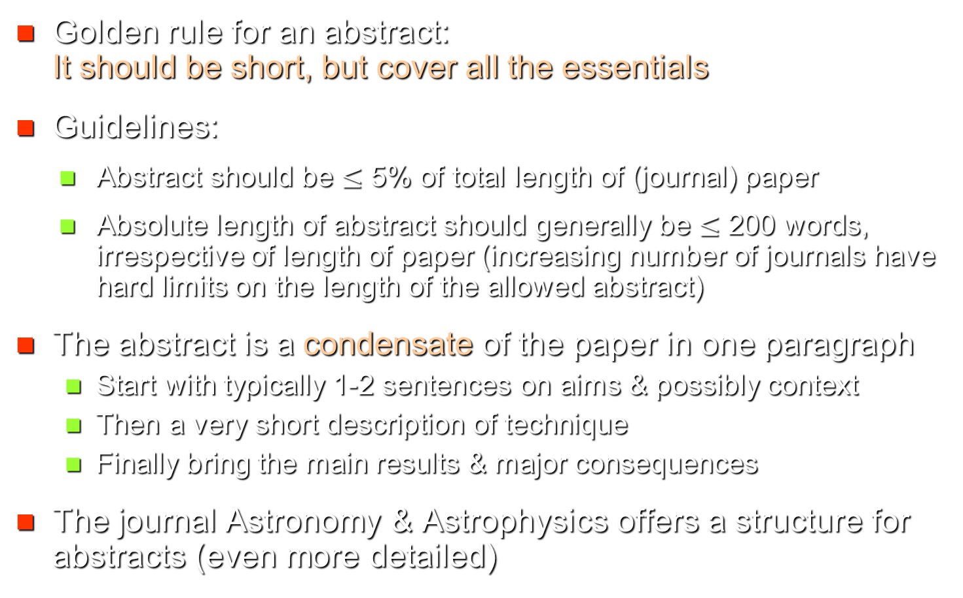
Abstract
Golden rule for an abstract: It should be short, but cover all the essentials
Guidelines:
  Abstract should be $≤$ 5% of total length of (journal) paper
  Absolute length of abstract should generally be $≤$ 200 words, irrespective of length of paper (increasing number of journals have hard limits on the length of the allowed abstract)
The abstract is a condensate of the paper in one paragraph
  Start with typically 1-2 sentences on aims & possibly context
  Then a very short description of technique
  Finally bring the main results & major consequences
The journal Astronomy & Astrophysics offers a structure for abstracts (even more detailed)
Notes:
Short, but cover all the essentials used to be said of women’s skirts, but now is construed as a sexist remark, so cannot be said anymore

Slide 22
Abstract: an example
Introduction Aim+Method Results Discussion
The extension of the sunspot number series backward in time is of considerable importance for dynamo theory. We have applied a physical model to records of the ¹⁰Be concentration in polar ice to reconstruct sunspot number between the year 850 and the present. The reconstruction shows that the period of high solar activity during the last 60 years is unique throughout the past 1150 years. This nearly triples the interval of time for which such a statement could be made.
80 words total

Slide 23
Abstract: a structured example
Abstract structure provided by the journal Astron. Astrophys.:
Context: Most studies of solar coronal loop dynamics are limited to a narrow temperature range, so that they may miss dynamics associated with cooling and heating events.
Aims: We present a study of the temporal evolution of coronal loops in active regions and its implications for the dynamics in coronal loops.
Methods: We analyzed images of the Atmospheric Imaging Assembly (AIA) on the Solar Dynamics Observatory (SDO) at multiple temperatures to detect apparent motions in the coronal loops.
Results: Quasi-periodic brightness fluctuations propagate upwards from the loop footpoint in hot emission at 1 MK, while sporadic downflows are seen in cool emission below 1 MK. The upward motion in hot emission increases just after the cool downflows.
Conclusions: The apparent propagating pattern suggests a hot upflow from the loop footpoints, and is considered to supply hot plasma into the coronal loop, but a wavelike phenomenon cannot be ruled out.
161 words

Slide 24
Abstract
No figures, no tables, no footnotes, no references to other places in the paper
Avoid, if possible, references to other papers. Examples of exceptions:
  if your paper mainly deals with results of another paper, it is o.k. to add reference (but some journals do not allow them at all in abstracts)
  if another paper is absolutely crucial for the methodology (and there is no standard name for the method)
Keep abbreviations, equations and symbols to a minimum
Make sentences short (this is a good idea anyway, also for the rest of the paper)
First person (“We have shown…”) is often not used in the abstract. I find it o.k., but first check if your journal allows it
Notes:
Exception for the “no references” rule: If the paper mainly checks the results of another paper or basically deals with an idea presented in another paper, then it may be appropriate to cite that paper. Usually any paper cited in the abstract has other authors.

Slide 25
Abstract
Write the abstract at the very end, after completing the rest of the paper, i.e. once you have found the best formulations for your main results and are firm about the conclusions
Finally, check the abstract for consistency with the rest of the paper:
  Is everything said in the abstract also said in the paper? The abstract should NOT contain any new information that is not already present in the body of the paper
  Does the abstract give all the main results & conclusions? It should not be missing the main results and main conclusions (without going into detail)

Slide 26
The Introduction
The introduction serves multiple purposes:
  It can state the general topic (subject area) of your work
  It gives the context of your work
  It gives the aim of your paper
  It tells what is new about your work
  It may give an overview of the structure of your paper
At the beginning of the introduction identify the topic & subject area of the paper if publishing in a journal that cover a broader field of research. This need not be longer than ½ ‒ 2 sentences. E.g.: The cause of solar coronal heating remains unresolved even after ….

Slide 27
The Introduction
Context of your work:
  Background and context of your work, i.e. what has been done before. This involves a short & balanced overview of the relevant literature
  Keep the overview reasonably short: the introduction of a research article is not a full-blown review. HOWEVER, do cite the papers that are closely related to yours, or are directly relevant for your paper. I have known referees to get very upset if they feel that crucial papers have not been cited
  Balanced: If there is a controversy, cite papers that favour both sides. Do NOT cite only or mainly papers by you, or your supervisor, or your institution, or your fellow nationals

Slide 28
The Introduction
Context of your work:
  Move from general to specific ➔ First discuss and cite the papers with basic, more general results (or reviews, which allows you to reduce the number of cited papers). Then move to the papers directly related to your work
  Avoid, if possible, citing general textbooks (e.g., general physics, astrophysics, or galaxies, etc.) since they contain things that are considered “common knowledge”.
  Minimize citing not widely available sources (e.g. theses, proceedings), or non-English language articles (the reader must be able to retrieve the information and read it).
  Best is to cite primary and review literature ➔ articles in refereed journals and review articles

Slide 29
The Introduction
Aims of your paper:
  Very important: Give the goals of your paper.
  Say why present work needs to be done. Why it is important
    E.g. because there is a gap in earlier work, which your work is now filling
    Or you are using a new method, or improved data, or …
    Or because there was an error in an earlier paper
    If criticism of earlier work is necessary, try to be mild. You don’t want others to be too harsh about your work either
  State how you approach the problem ➔ from ½ to a few sentences on the method used (e.g. “We employ 3-D radiation-MHD simulations to study ….”)

Slide 30
The Introduction
Aims of your paper:
  Stress what is new or different in your work compared to what has been done before
  This is important for readers, because it tells them why they should be reading this paper (or if they should not be)
  You can mention broader applications of your work here, or in the Discussion + Conclusions section (or in both places)
  Possibly also point out restrictions/assumptions (given in detail in Methods & Materials). E.g. “Our simulations are restricted to ideal MHD…” Plus state your main assumptions (E.g. “We assume that the object remained unchanged over the 7 nights of our observations …”)

Slide 31
The Introduction
Often done, but not necessary: give structure of remaining paper in last paragraph of introduction. E.g. “In Sect. 2 we describe the data and the reduction procedure, in Sect. 3 …”
Many first-time authors find the Introduction very hard to write. They often put off writing it till the end (or ask coauthors to write it)
Advantages of writing Introduction early:
  It helps you to learn what others have done & to put your work in context
  It helps you to identify what is really new about your work and the main message of your paper
  Getting to know the literature & identifying gaps in knowledge is an important step in becoming an independent scientist

Slide 32
Plagiarism
Plagiarism = including text from a published source (a paper, book, website, or PhD thesis) without referencing the source. Best put directly copied text in quotation marks “…”
Copying sections or paragraphs from other papers, including your own, may seem inviting since they are already well formulated. Avoid it!
If you do that you may end up with a paper that is both “good and original” according to Samuel Johnson, but “the parts that are good are not original and the parts that are original are not good”

Slide 33
Plagiarism
Reasons for avoiding plagiarism:
  Plagiarism can end your scientific career. Students caught plagiarising are refused a PhD (I know students to whom it happened!)
  It may even end your career outside science, e.g. ex-ministers zu Guttenberg & Schavan (although not a clear case of plagiarism in her case), and many others
  Thanks to really smart software and fast data bases, it is now really easy to catch plagiarism
  In our IMPRS all PhD theses are checked for plagiarism. Some journals and ArXiv now also do it as a matter of course
  Don’t plagiarize; it isn’t worth it!

Slide 34
Be honest
Don’t invent or change results
Only describe what you have actually done
Don’t claim others’ results as yours

Slide 35
Methods and Materials
Describes the instruments and data used, as well as the analysis techniques. It may be called differently or can be broken into 2 or more sections, or subsections
Examples of alternative section titles:
  Code and computational technique (appropriate for a numerical paper)
  Instrument and measurements (e.g. if a new instrument is being described or used)
  Data and analysis technique (e.g. for a data analysis paper)
  Observational data + Method of analysis (broken into 2 sections, if sufficiently long)

Slide 36
Methods and Materials
Scientific results must be reproducible. Methods and Materials section is key to ensuring reproducibility of your results ➔ it describes what you have done, how you have done it and with which tools
Times & dates of your observations can be important, e.g. when studying variable phenomena (such as a stellar outburst). Also allows readers to check your results with the same data, e.g. from space missions (reproducibility)
This section is often studied carefully by the referee. It can decide whether he/she feels that the results can be trusted or not

Slide 37
Methods and Materials
Find the balance between
  Describing everything important
  Leaving out everything not needed
Rule of thumb:
  New method, new instrument, new type of data ➔ Describe in detail, since required for reproducibility
  Known method or instrument, previously used and described in other paper(s) ➔ Often a reference and a short summary is sufficient
Do not repeat published descriptions ➔ cite the paper giving the description, if needed together with a short summary
Also important for all
other parts of a paper

Slide 38
Methods and Materials
Often a figure can illustrate & clarify a new method, or an unusual instrumental setup. More about figures later
A table can also be quite useful in this section
  E.g. to list the observations/measurements and data sets used
  Or, for a numerical paper, to list the various runs with a code (e.g. with different parameters).
  Make sure that you identify the parameters that are changed and list their values

Slide 39
Results
The core of the paper, where the results obtained during the long labour of research are presented
Be concise. Pre-select the results (i.e. identify the important and new results) before writing about them in the results section
➔Keep in mind: The fool collects facts, the wise man selects them
(John W. Powell)
(but don’t try to be too wise too early! First collect all the facts, then select them)
Avoid repetition! (yes, I know that I’m repeating this statement, but this is a talk and not a paper)

Slide 40
More Results
What to put into the Results section and what in the Discussions section?
General guideline
  In the Results section you only describe the results, but usually do not interpret them or put them in context (by comparing with literature). E.g. you only cite papers that are very directly relevant or affected by your results
  In the Discussion section provide the interpretation and the comparison with the literature, without repeating all the results

Slide 41
Results: Figures
Figures are important to visualise results
  If you want to express a relationship, or point out a feature in your data, or show how the solution of an equation behaves it is often best to make a figure
  Figures are generally to be preferred over tables, if you have more than a few numbers.
    Well-made figures are much easier to understand than tables
    E.g. a relationship between two quantities becomes clear in a figure, but will likely be difficult to deduce from a table
  Only very few types of paper might work without any figures. E.g. an analytical theory paper (e.g. a derivation or new solution of an equation)

Slide 42
Results: Figures
One way to structure the Results section is to write it around the figures and tables presenting the main results.
First prepare & order the figures & tables presenting the results. Then write the main text following them
However, do not forget to make a logical order! ➔ Make a story
Each figure must be referred to in the text (with Fig. 1 being the figure first referred to in the text, Fig. 2 being the next referred figure, etc.). Same is true for tables

Slide 43
Results: Figures
Each figure must have a caption
  Captions should be short, but self-explaining, since often figures are looked at before the text is read. If symbols or abbreviations are used, then they should be (briefly) defined in the first figure caption in which they appear
  Captions should only clarify what is plotted and not interpret the figure. Interpret and discuss the figures in the main text only
  Captions are generally put below the figure (usually done automatically by journal style files), sometimes beside the Fig.
  Use letters to identify subfigures. Refer to them as “Figs. 1a and b”. Write “a” and “b” in large font in the appropriate panels of the figure

Slide 44
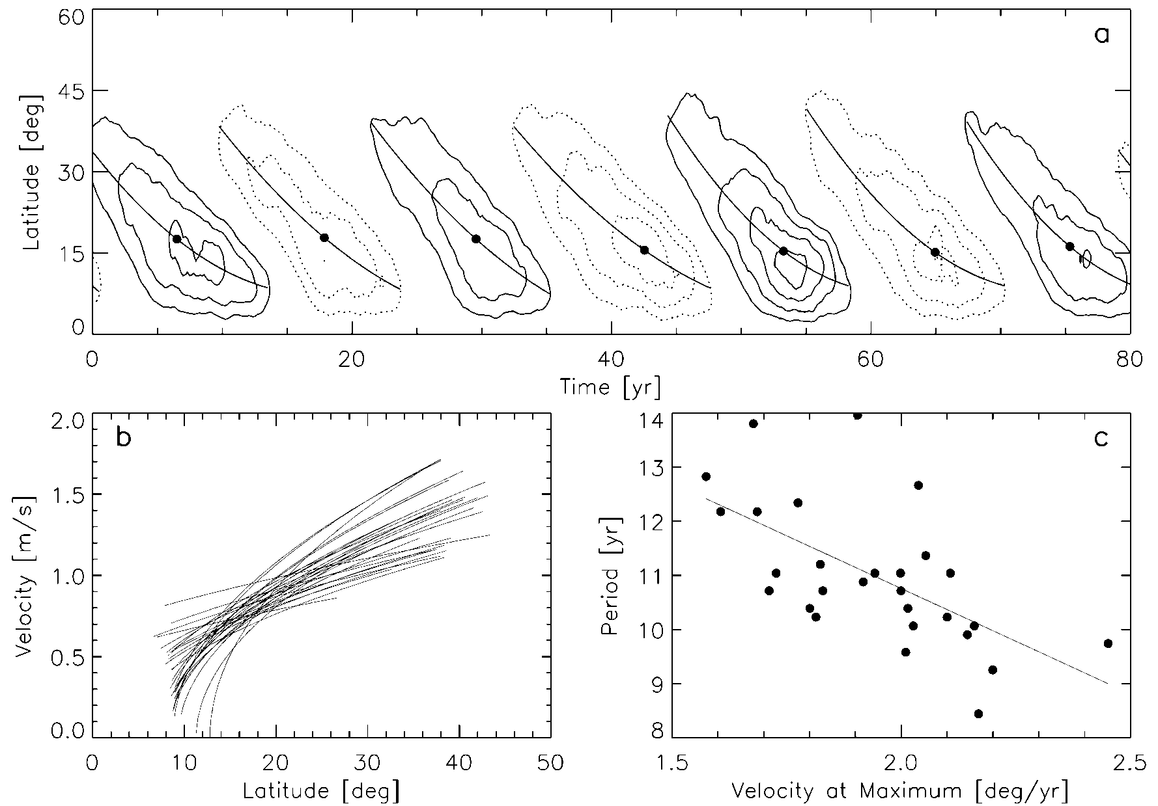
Multipanel figures
Mark individual panels of a multipanel figure by a, b, c… Much better to say “Fig. 1b” than saying “lower left panel of Fig. 1”.
a
b
c
Also, journals often have more than one layout for manuscripts and panel placement can change from one layout to another

Slide 45
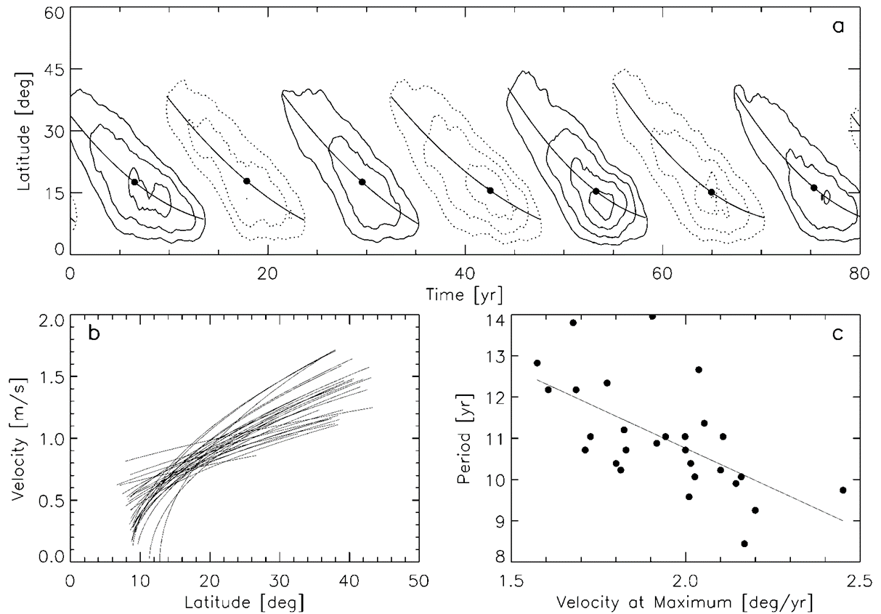
Types of Figures
X-Y line graphs
  Data points are linked by a line (shows dependence of one variable on another, with a particular order of the points)
line graphs

Slide 46
Types of Figures
Scatter plots
  Same as X-Y line graphs, but the points are in no particular order & are not connected by a line
scatter plot with regression line

Slide 47
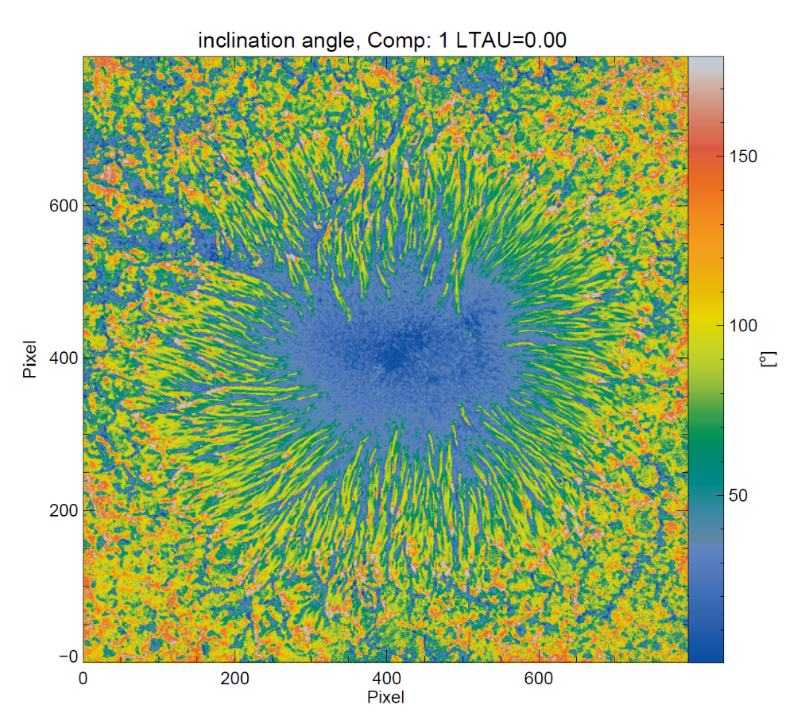
Types of Figures
Image
Contour plots, surface plots, images
Different ways of representing 2-D data sets
Y [Pixels]
Contour plot with embedded line graphs
Colour bar
X [Pixels]

Slide 48
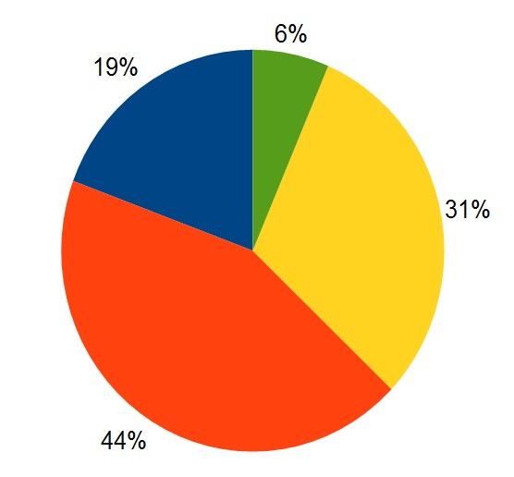
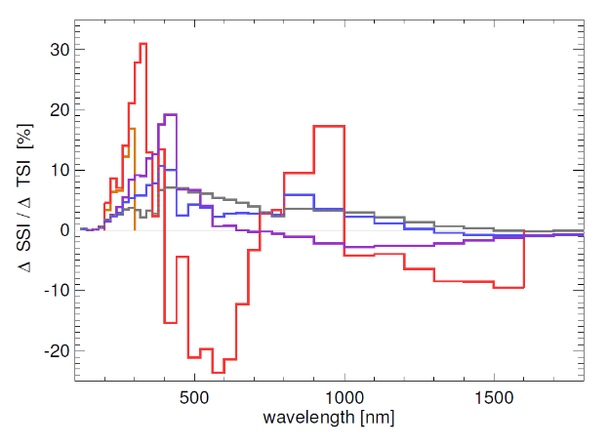
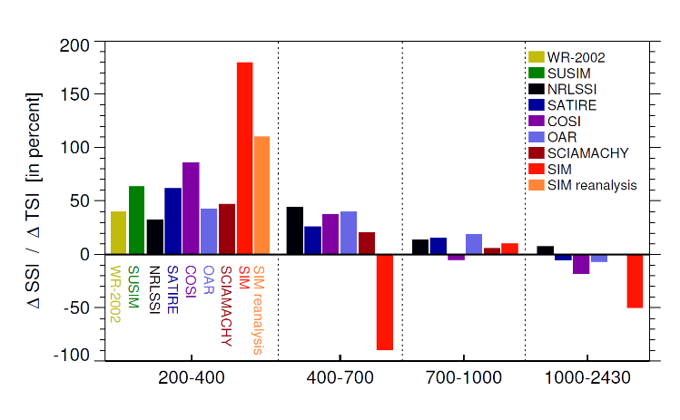
Types of Figures
Histograms, bar charts, pie charts
  Represent distributions, fractions & their evolution (bar charts & pie charts are not so common in astrophysics)
Histogram
Bar chart
Pie chart
Wavelength ranges

Slide 49
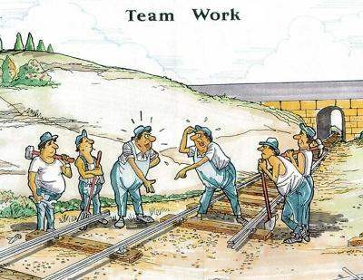
Types of Figures
Sketches, cartoons
  Used to illustrate a concept, or a geometry, or a procedure
cartoon

Slide 50
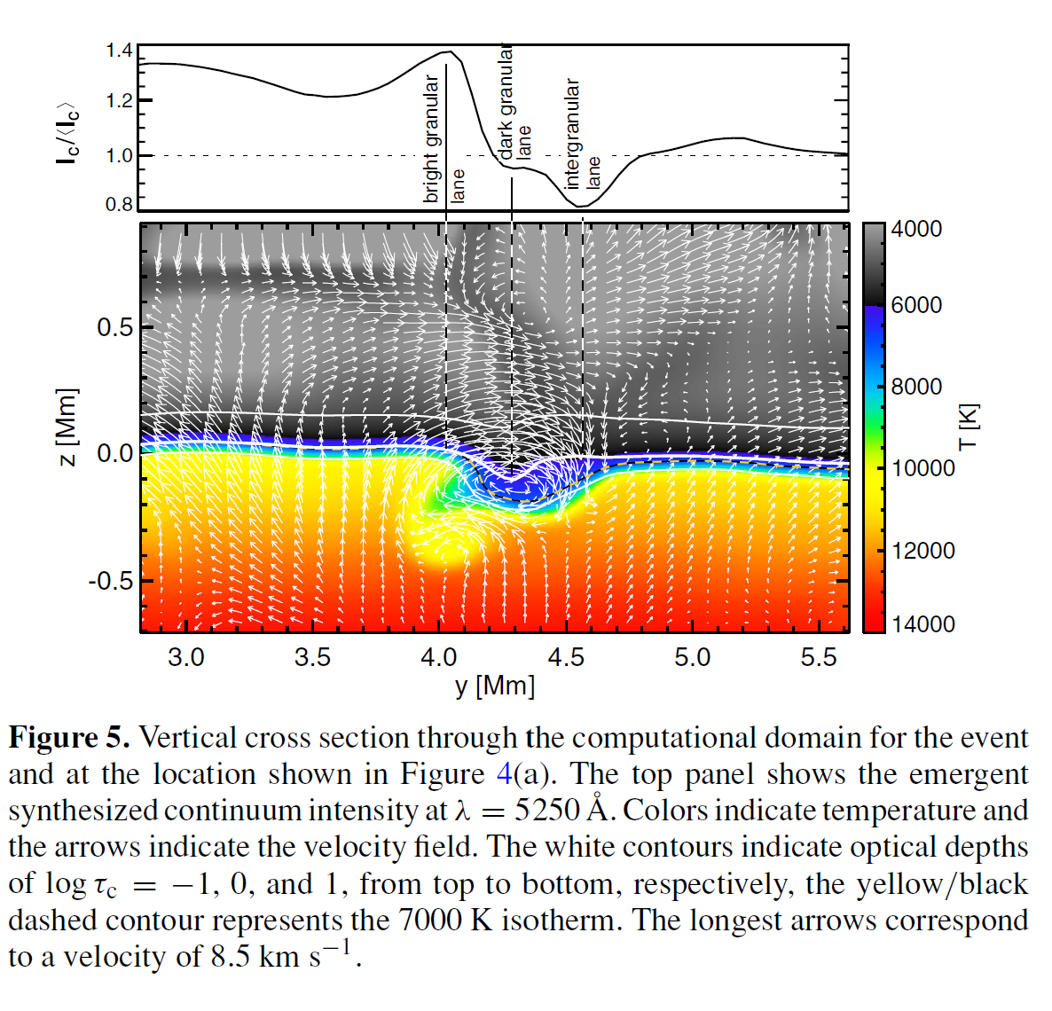
Example figures
A complex figure combining a colour image (note colour bar on right) with a line graph
Long caption due to complexity of figure

Slide 51
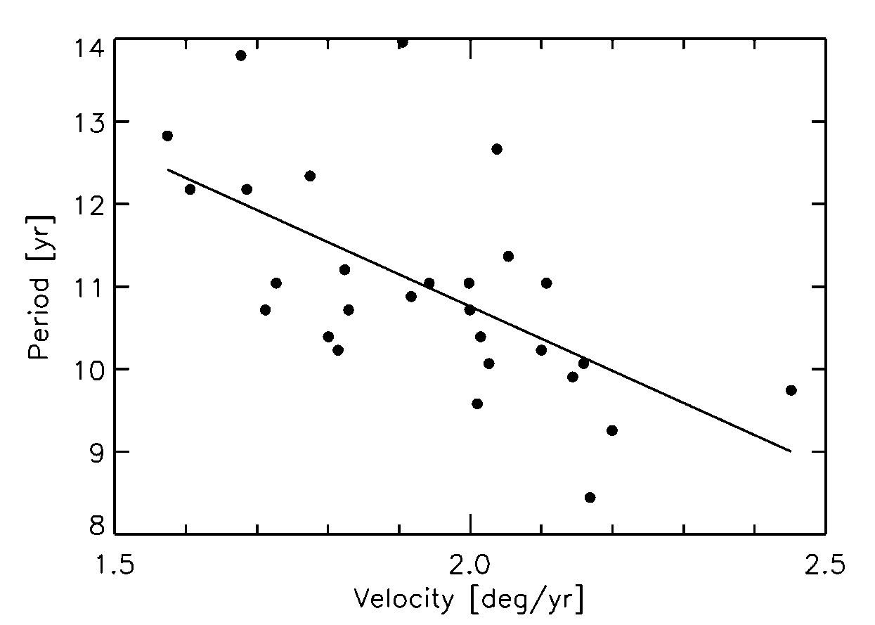
Anatomy of a Figure
Title?
Y axis
Data
Axis label
Symbol
Minor tick
Major tick
Caption
X axis
Figure 1. Solar cycle period vs. latitudinal drift velocity at cycle maximum,
taken from an αΩ-dynamo model. The dots represent the data of 28 simu-
lated cycles and the line denotes a linear least-square fit

Slide 52
What to observe when plotting figures
Label the axes, give units
Line thickness, image resolution
Type & size of fonts of axis labels
Number and size of major and minor ticks. In final figure, label fonts should have same size as main text fonts
Axes ranges (round numbers, fill the frame!), linear/log scale
Line style, symbols (type & size), color (cost?).
Give a key to symbols (either in plot or in caption)
Don’t overload figures (do not plot many different quantities)
Caption: must give all the information needed to understand the figure, but is not a discussion (possible exception, if it is the main result of paper)
Depend on journal & final size of figure

Slide 53
Animations
Many journals now allow animations.
Some also allow interactive figures, where the reader can manipulate the data in the figure, which can help to clarify different cases
Of course, animations and interactive figures only work in the electronic format. Some journals treat them as supplementary material
All such extra material must be referred to within the main paper, although details differ from journal to journal
  E.g. ApJ requires that a frame from the animation is shown as a regular figure (and referred to within the main text). In the caption it must then say: "This figure is also available as an animation."

Slide 54
Tables
Figures are generally the first choice compared to tables
Make a table if you have multiple numbers to show
  but, e.g., there are too few of them to put into a figure,
  or if the exact values (e.g. 4.1568) are important
Tables can also list words, e.g. names or properties, which look clumsy in figures
Tables may be useful in other sections besides results. E.g. a table of observations in Methods Sect., or a table in Discussion Sect. listing literature values of a quantity
Each table must have a title. Keep it short
Each table must be referred to in the main text and the contents of the table must be discussed

Slide 55
More Tables
Describe the different columns of the table, i.e. explain/define what is listed in each column. E.g. as footnote to table or in main text (follow journal style)
  Name the variable/parameter being listed in the first row (header) of the table. Give units. Separate the header from the rest of the table by a horizontal line
Some journals publish long tables electronically only. Possibly put particularly long tables in appendix
Footnotes: many tables have footnotes. E.g. source of the listed data is often given in a footnote to the table

Slide 56
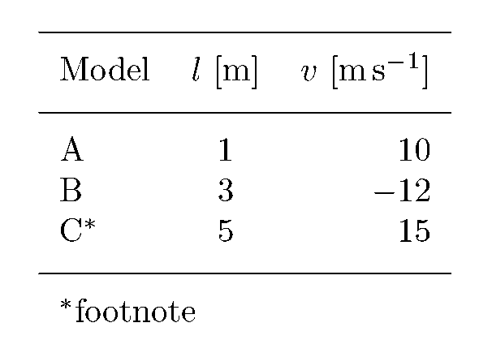
An example of a short Table
Table1. Title of the table

Slide 57
Discussion and conclusions
In this section the already presented results are discussed and conclusions are drawn from them
Sometimes broken up into separate sections, e.g., one entitled “Discussion”, the other “Conclusions”
You may BRIEFLY repeat the MAIN result(s). However, avoid presenting again all the results found (unless the paper leads to a single or just a few major results)
This is often a difficult section to write. Drawing sound conclusions from experimental or theoretical results is not always straightforward. It is an exercise in logic, & requires some knowledge of the literature & experience
You must have robust evidence for any conclusions you reach

Slide 58
Acknowledgements
The acknowledgements are generally placed between the end of the regular text and the references
People who have contributed to the paper, but not by a sufficient amount to be included in the author list, should be thanked in the acknowledgements
Discuss with your supervisor, which people should be acknowledged
Often you need to acknowledge your funding agency (some of them require it!)
IMPRS students must acknowledge the IMPRS
Always acknowledge people before organisations! People do notice the order, but organizations do not

Slide 59
References
Important! Check style manual of journal to which you wish to submit the paper. Journals have widely different styles for references and from time to time change their reference style
In astrophysics often: alphabetical and chronological, e.g.
  Aabacher A., 2014, J. Irreproducible Res. 15, A16
  Bardot B., 1922, B&B 2, 2222
  Chaplin, C., 1977, in Soundless Movies, ed. C. Cardinale, Hollywood University Press, Hollywood, p. 777
  Duck D., 2011, The adventures of Daisy D., Disney Academic Press, Disneyland
  Duck D., and McDuck S., 1999, Goofy’s Mag. 13, 13
  Duck D., McDuck S., and Mouse M., 1933a, ApJ 33, 444
  Duck D., Mouse M., and McDuck S., 1933b, ApJ 44, 333

Slide 60
References
Important! Check style manual of journal to which you wish to submit the paper. Journals have widely different styles for references and from time to time change their reference style
In astrophysics often: alphabetical and chronological, e.g.
  Aabacher A., 2014, J. Irreproducible Res. 15, A16
  Bardot B., 1922, B&B 2, 2222
  Chaplin, C., 1977, in Soundless Movies, ed. C. Cardinale, Hollywood University Press, Hollywood, p. 777
  Duck D., 2011, The adventures of Daisy D., Disney Academic Press, Disneyland
  Duck D., and McDuck S., 1999, Goofy’s Mag. 13, 13
  Duck D., McDuck S., and Mouse M., 1933a, ApJ 33, 444
  Duck D., Mouse M., and McDuck S., 1933b, ApJ 44, 333
Author(s), year of public., Journal, issue, 1st page or article No.

Slide 61
References
Some journals require paper titles and/or end-page numbers. E.g. Kong, K., 2005, Hanging out on the skyscrapers of New York, Movie Monthly, 1001, 2001-2002
Other journals: references are numbered in the order in which they are cited in text. Best use automated numbering scheme (provided by, e.g., LaTeX)
If you are using unpublished data or results of another researcher, then cite him/her in the text. E.g., (M. Monroe, 1944, private communication). But: Ask before you cite!
No private communications or unsubmitted papers in the reference list. Keep such citations strictly to the main text and keep them to a minimum!

Slide 62
References
Many journals: if there are more than six authors, then only the first three are explicitly listed:
Angel, A.N., Devil, B.A.D., Saint, St., et al. 2022, Heaven & Hell Monthly
Papers that have been submitted, but not yet accepted for publication are cited as “submitted”, those that have been accepted as “accepted”, or “in press”, or “in the press”, e.g.
Gaga, L., 2019, Greatest Hits, in press (arXiv:1111.3333)
Bobo, D.J., 2018, Smallest Misses, submitted
If an unpublished paper is on ArXiv or astro-ph, give the relevant number when citing it (e.g., arXiv:1202.3554)
See special instructions by the journal to refer to websites (e.g. websites hosting codes, or data bases etc.)

Slide 63
References: avoid errors
Many errors are propagated in References
  Are all papers cited in text also present in the references and vice versa?
  BibTeX is a great help in establishing consistency
  Have you really included the reference to the correct paper? I have often found that a student has put in a reference to a conference proceedings paper with little info. instead of citing the journal paper of the same year
  Make sure the references are correct (up to 25% of references in literature are incorrect according to study in Lancet)!
    Check in a data base, such as ADS, which provides references in BibTeX format
    However: ADS also has errors ➔ Best is to check original paper!
Notes:
Survey of papers published in Lancet -> about 25% of all references were incorrect in one way or another. In over 10% of all references the error was so bad that the original could not be found. Easier nowadays, but still problematic

Slide 64
Citing references
Cite by first author name and year of publication. E.g.: “Duck et al. (1933a) claimed that ducks can talk” or “There is a dark side to every force (Skywalker et al. 2384; Vader & Palpatin 2388).”
  Note that in a list, papers are separated by either a semicolon ; or a comma , (according to the journal)
In general cite multiple papers in chronological order. E.g. “As demonstrated by Venus et al. (1888), Jupiter et al. (1919) and Mars et al. (2002), the planets are a friendly bunch of heavenly bodies” However, some journals require, e.g. alphabetical order.
Avoid using the words of other authors to describe their (those authors’) main results. Reformulate!

Slide 65
Appendices
Material that may be of interest for a few readers, but not for most (e.g. lengthy tables, derivations of equations, details of the method) can be put into an appendix or into multiple appendices
Appendices are optional. Many papers do not have an appendix
An appendix must be referred to in the main paper. E.g., “The derivation of Eq. (15) is given in Appendix B.”
Only the most interested readers will go through the appendix, so don’t put anything in there that is crucial for your conclusions

Slide 66
Supplementary or online material
Many journals allow adding supplementary material (often only provided online and not printed)
Online material can include:
  appendices
  long tables, original data
  source code
  movies, animations
Since few people go to the library anymore, this is a way of extending the presentation of your results
Remember, most readers will ignore the supplementary material, except perhaps the movies

Slide 67
After finishing to write
First revise what you have written
Important: Check for consistency. Make sure that you say the same thing everywhere in the paper. Inconsistencies can easily creep in during the weeks spent writing different parts of a paper, but they are noticed when reading it in one go
Then: Revise again!
Only then: Show the paper to your supervisor and/or co-authors
Notes:
KOREAN VERSION

Slide 68
Style
Scientific publications have their own style, different from the spoken work, different from the style of newspapers, or most literature
The aim of a scientific paper is to transmit to the reader what you have done and the results you have found. Remove everything not needed for this
➔The style should be precise, clear, simple and concise (i.e. short)
Golden rule of paper writing style: KISS
Keep It Short & Simple
Notes:
Golden rule No. 2 of paper writing style: KISS (for those not paying attention to Golden Rule No 1)
Keep It Simple, Stupid!

Slide 69
Style: simplicity
Write complete, short and simple sentences.
An example of a sentence that is perfectly correct, both in language and content, but does make heavy reading:
  “The apparent galactic contrast, given here by the RMS intensity contrast of NGC 1048, in Hubble filter observations, restored by the deconvolution with the PSF, exhibit reasonable agreement with that in numerically synthesized intensity maps, demonstrating that the PSF, though inexact, returns a competent estimate of the aperture diffraction and stray light-free contrast.”
  7 commas in this one sentence --> break into multiple sentences...
Referees often complain that a paper is too difficult to read or obstruse, but no referee ever complained that a paper is too easy to read… (experience of Maria Cruz, previous Astronomy Editor of Science Magazine)

Slide 70
Style: Precision
Be precise!
Andreas Johannson: “Fuzzy language is a reflection of fuzzy thinking” ➔ show that your thinking is not fuzzy
  Choose your words carefully to say precisely what you need to say: define terms, use correct names, and universal labels and analogies
  Provide numbers whenever it makes sense
Choose your words carefully: Try to avoid writing things in a way that can be misunderstood. This is not easy and requires practice. It leads to language that is different from everyday english ➔ scientific english
Notes:
AN EXAMPLE IS NEEDED FOR THIS SLIDE!

Slide 71
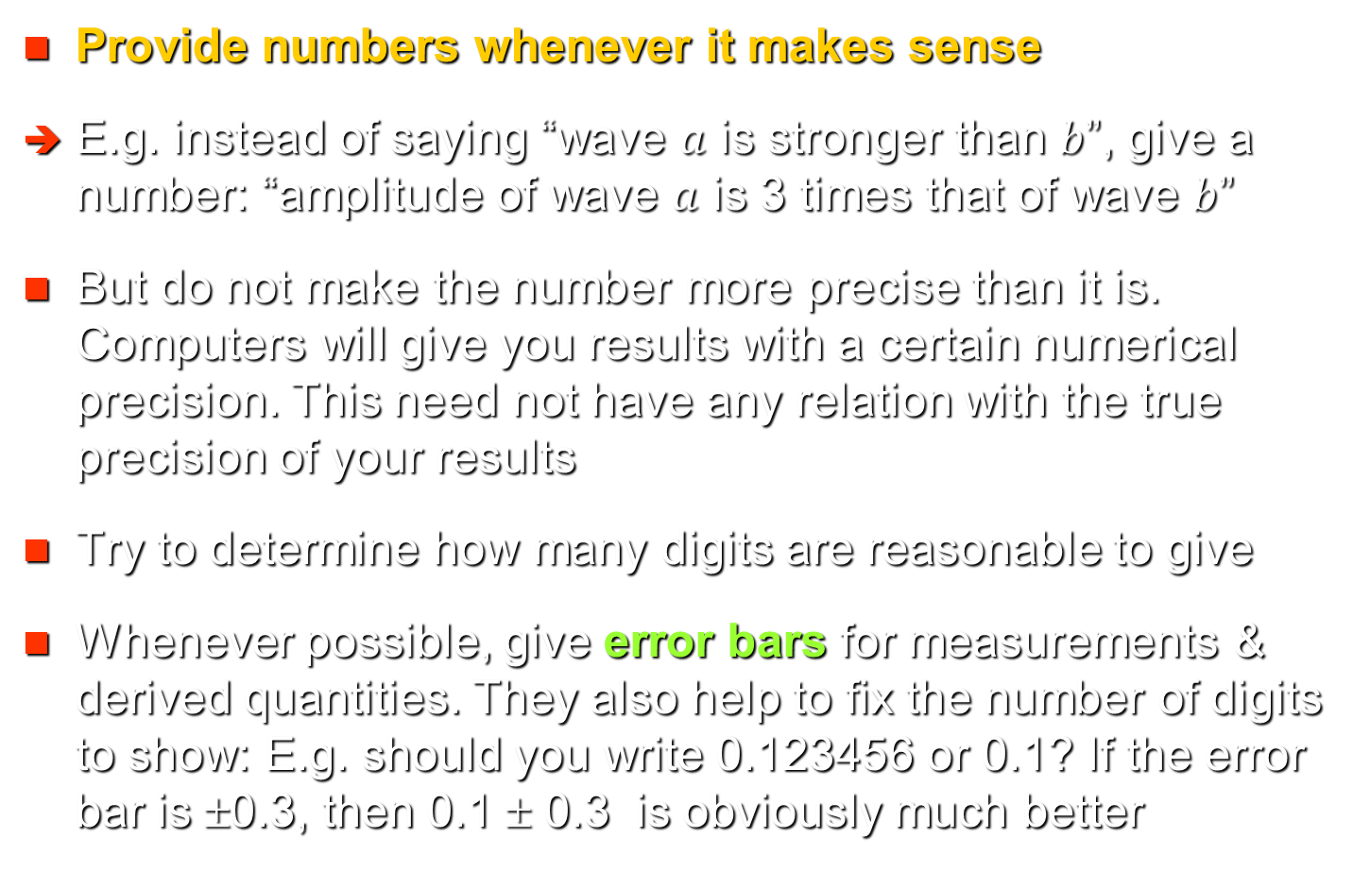
Style: Precision
Provide numbers whenever it makes sense
E.g. instead of saying “wave $a$ is stronger than $b$”, give a number: “amplitude of wave $a$ is 3 times that of wave $b$”
But do not make the number more precise than it is. Computers will give you results with a certain numerical precision. This need not have any relation with the true precision of your results
Try to determine how many digits are reasonable to give
Whenever possible, give error bars for measurements & derived quantities. They also help to fix the number of digits to show: E.g. should you write 0.123456 or 0.1? If the error bar is ±0.3, then 0.1 ± 0.3 is obviously much better

Slide 72
Style: Units
If a number is not dimensionless, give its units
Use the SI system if possible
Some exceptions:
  In papers with electrodynamics often cgs units are used, since equations are simpler
  Ångstrom, Å, is an officially accepted unit for length in astronomy (especially for wavelengths) also in SI units
  Many authors prefer to use Gauss instead of Tesla
Unit is given after a number: use the abbreviation. E.g. “The Fe I line at 525.02 nm is sensitive to …”
In the text write out the complete unit. E.g. “All wavelengths are given in nanometers.”

Slide 73
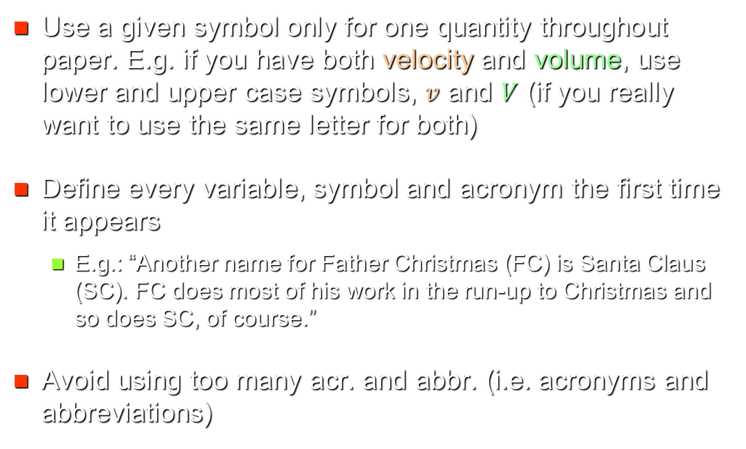
Style: Symbols and acronyms
Use a given symbol only for one quantity throughout paper. E.g. if you have both velocity and volume, use lower and upper case symbols, $v$ and $V$ (if you really want to use the same letter for both)
Define every variable, symbol and acronym the first time it appears
  E.g.: “Another name for Father Christmas (FC) is Santa Claus (SC). FC does most of his work in the run-up to Christmas and so does SC, of course.”
Avoid using too many acr. and abbr. (i.e. acronyms and abbreviations)

Slide 74
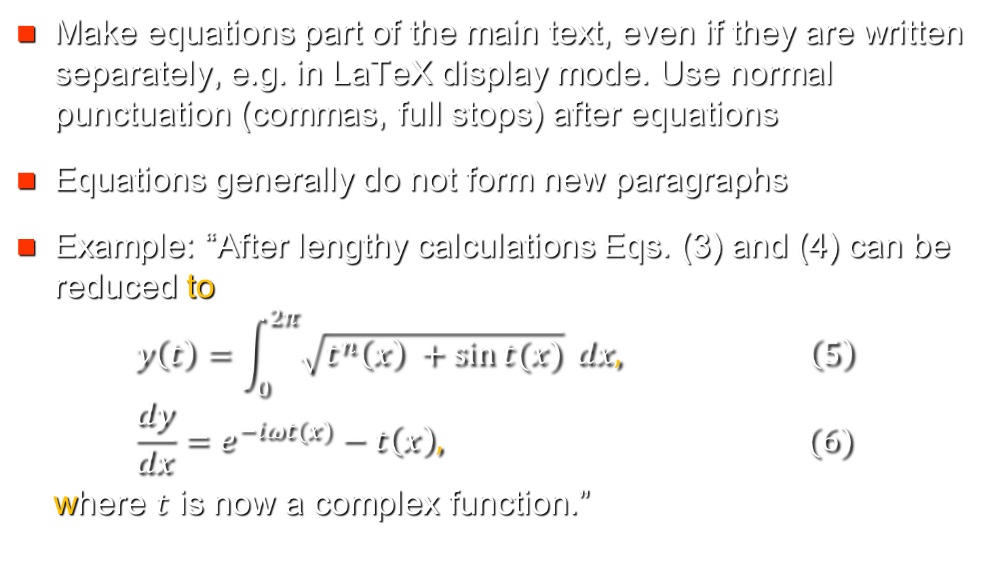
Style: Equations
Make equations part of the main text, even if they are written separately, e.g. in LaTeX display mode. Use normal punctuation (commas, full stops) after equations
Equations generally do not form new paragraphs
Example: “After lengthy calculations Eqs. (3) and (4) can be reduced to
$$y\left(t\right)=\int_{0}^{2π}{\sqrt{t^{n}\left(x\right) +\sin{t(x)}}} dx, \left(5\right)$$
$$\frac{dy}{dx}=e^{−iωt\left(x\right)}−t\left(x\right), (6)$$
where $t$ is now a complex function.”

Slide 75
Which journal?
The journal is best chosen before starting to write
Criteria for choice of journal:
  The journal should cover your field and should be read by colleagues
  The journal should have a good reputation
  Monetary considerations: page charges (if any), cost of printing in colour, free (possibly electronic) reprints provided? Do you have to pay if you later use one of your own figures in another of your papers (e.g. in a review)?
  Is the journal open access? Are you at least allowed to put your paper in a public repository (e.g. ArXiv)?

Slide 76
Which journal?
Examples of appropriate journals (w. page charges):
  General: Nature, Science, Publ. Nat. Acad. Sciences
  Physics: Phys. Rev. Lett., Phys. Rev. A-E, Nature Phys.
  Astronomy (including solar system studies): Astronomy & Astrophys., Astrophys. J., Astron. J., Monthly Not. Royal Astron. Soc., Nature Astron., Publ. Astron. Soc. Japan, Publ. Astron. Soc. Pacific
  Specializing in solar phys.: Solar Physics; JGR A, GRL
  Specializing in planetary science & geophysics: JGR, GRL, Annales Geophysicae, Icarus, Earth Moon & Planets
This is an incomplete list, even in the field of solar system science
Notes:
ISI (Inst. of Scient. Information) a private company sets up the ranking of journals based on impact factors. Did not include references to A&A or ApJ into their list, since they judged these abbreviations to be too short and not unique..... Error roughly a factor of 2!
Impact factors of Nature and Science so high (30) in particular due to many biological and medical papers therein.

Slide 77
Which journal?
What determines the reputation of a journal?
  Impact factors: How often articles in the journal are cited on average in the first 2 years after publication.
    Nature ≈ Science > PNAS ≈ Phys. Rev. Lett.: highest impact factors
    Important: Citation rates depend very much on research field (E.g. General astrophysics > solar physics > planetary science)
    Important: Better a high impact paper in a low impact journal than vice versa. Quality of your paper is more important than the journal
  What senior/leading scientists think of a journal
The second criterion is the more important one ➔ Ask your supervisor and other experienced scientists in your field about the appropriate journal
Notes:
ISI (Inst. of Scient. Information) a private company sets up the ranking of journals based on impact factors. Did not include references to A&A or ApJ into their list, since they judged these abbreviations to be too short and not unique..... Error roughly a factor of 2!
Impact factors of Nature and Science so high (30) in particular due to many biological and medical papers therein.

Slide 78
Which journal?
Business models of publishers
  Subscription only: readers pay to read, either via a subscription or by buying an article at a time. Authors do not pay to publish.
  Open access: authors pay page charges to publish. Readers can read for free
  Mixed: both authors and readers pay
Advantage of open access: In general, your paper is more likely to be read and cited if it is open access
Problem with some open access journals: since authors pay, the journals may be lenient & publish poor papers (they have no responsibility to readers)

Slide 79
Which Journal?
Warning: there is an increasing number of “predatory journals” out there
  Online-only, open-access journals (i.e. the authors pay for all costs), some run by dubious companies/individuals
  They often spam scientists with e-mails trying to attract submissions, editors, etc. ➔ predatory
  They typically publish any paper sent to them without proper quality control (refereeing), as long as the authors pay
  In the best case, your paper will be ignored by the community
  In the worst case, they will hold your paper ransom & charge much more than originally agreed, or not publish it, but keep the money

Slide 80
Submission
When ready to submit your paper
  Read the journal’s instructions to authors on submitting
  Usually, you upload the manuscript to publisher’s website
  Make sure your paper is in the format that the journal requires (e.g., some journals require two manuscripts, one in print-layout, one in a more spacious referee-layout)
  Make sure that you also upload all supporting material (movies, online material, etc.)
  Make sure all files have the appropriate names as required by the journal
  Provide a cover letter to the editor (or fill the online form)

Slide 81
Submission: sample cover letter
Dear [Editor name],
I/We wish to submit an original research article entitled “[title of article]” for consideration by [journal name] (…in the section [section name; only if journal has multiple sections, such as Astron. Asrophys.]).
I/We confirm that this work is original and has not been published elsewhere, nor is it currently under consideration for publication elsewhere.
(In this paper, I/we report on / show that ___. This is significant because ___. We believe that this manuscript is appropriate for publication by [journal name] because it… [reference to the journal’s Aims & Scope]. ____. ) [Briefly describe the research you are reporting in your paper, why it is important, Pand why the manuscript belongs in this journal. Do not repeat your abstract here! This part is optional]
We have no conflicts of interest to disclose.
If you feel that the manuscript is appropriate for your journal, we suggest the following reviewers: [List reviewers and contact info, if requested by journal]
Please address all correspondence concerning this manuscript to me at [email addr].
Thank you for considering this manuscript for publication in [journal name].
Sincerely, [Your name]
Adapted from Taylor&Francis AuthorServices

Slide 82
The refereeing process
Every suitable paper submitted to a respectable journal is sent to a referee (some journals send papers to 2 referees) to judge its merit and to advise the editor to accept or reject the paper. The editor decides!
The referee will generally recommend to (categories may differ from one journal to another)
  publish without changes (rare)
  publish with minor changes (the referee generally does not see the modified version again before printing)
  publish with major changes (the referee is sent the revised version to comment on)
  not publish in its present form, but resubmit after major modifications (to then be treated like a new submission)
  reject, i.e. not publish at all

Slide 83
Most common reasons for rejection of a manuscript

Slide 84
Dealing with referees’ reports
At first sight referees’ reports often look more negative than they really are
➔Read the report, show it to your supervisor. Then put it away for a few days (& calm down). Only then read it again & make the requested changes to the paper
Send a reply to the referee along with the revised paper:
  In the reply, point out how you have taken his/her comments into account in the revised manuscript
  If you disagree with the referee and haven’t implemented one of his/her suggestions, then explain why not
Referees are (usually) not stupid. If he/she misunderstood something, then likely the paper is not clear at that point ➔ Make it clearer

Slide 85
Dealing with referees’ reports
Remain polite. Usually the referee is trying to help. It is better that the referee catches any errors before the paper is published. Even if the referee is nasty, usually little is gained by showing your anger
If you feel that you are being unfairly treated by the referee you can ask for a second opinion.
  Only worth doing if your paper gets rejected & you have good scientific arguments why referee’s criticisms are unfounded
  Editors generally send paper and report of referee 1 to referee 2. If 2nd referee also rejects the paper, then that is generally it
  Example of an exception: Parker’s solar wind paper
Notes:
Parker submitted paper to ApJ, to Chandra who was editor at that time and also at Chicago. 1st referee negative: must be an error, but can’t place finger on it. 2nd referee equally so. Parker doesn’t find error despite repeated looking. Chandra decides to publish it although no referee ever agreed.

Slide 86
Dealing with referees’ reports
All authors are required to agree with both, the revised version of the paper and the reply to the referee
Please make sure that all your co-authors have a chance to see and comment on the revised version
As a matter of courtesy please send your paper to your co-authors in the version that was submitted and also once it has been accepted, in the finally accepted version

Slide 87
Language editing and proofs
After the paper has been through the refereeing process, you might get comments from the language editor
Make the proposed changes, unless you disagree & feel the language editor made a wrong suggestion (misunderstood)
Write briefly why you did not make a particular change
Finally, you’ll get the “proofs” or “galley proofs” of your paper. This is the final typeset paper as it will appear in the journal
Go through them VERY carefully. The journal staff may have made mistakes anywhere. Title, author list, affiliations, abstract, main text, figures (!!), captions, acknowledgements, references: check them all!

Slide 88
Making your paper available to the community
Publication typically takes 4-10 months from submission
Scientists therefore often used to send (printed) “pre-prints” to each other
Now electronic preprint servers do the job:
  I suggest you put your paper on the Arxiv or astro-ph server http://arxiv.org/ (all physics + maths + others)
  http://arxiv.org/archive/astro-ph (only astrophysics)
  Astrophysics (incl. solar) papers put on this preprint server are cited nearly twice as often as papers not on the server (open access!)
  It is generally wise to wait until your paper is accepted for publication before you put it there! Otherwise you might have a paper in public that bears little resemble with the published one…
  Citing papers on astro-ph: cite them as “in press astro-ph/ .......” (number assigned by data base to that article)

Slide 89
Making your paper available to the community
Many journals have no problem with you making your paper available on a preprint servers. Some journals, however, forbid it
Important: German law since 2014: Every author has the right to put his/her scientific paper on a public server at the latest one year after publication, even if he/she has signed all his/her rights to the publisher

Slide 90

Ph.D. Thesis

Slide 91
Ph.D. Theses
Basic structure of a Ph.D. thesis can follow two paths (Some Universities/faculties leave you no choice):
  Path 1: Like a long research paper: IMRaD (often with multiple Results chapters)
  Path 2: A succession of independent & complete (published) research papers plus an introduction and final conclusions
In both cases the following parts are necessary:
  Summary [language(s), form & length often prescribed by the university]
  Introductory chapter: Review of the field, to show that the student has mastered the literature and background
  Conclusions chapter, including an outlook for future work. To show that the student has got his/her own ideas for future work & is ready for independent scientific work. I find this necessary

Slide 92
Ph.D. Theses
University of Göttingen allows paths 1 or 2. No need to rewrite the text of the papers (but you should reformat them, so that the thesis is in a homogeneous format)
A Ph.D. thesis is considerably longer than a typical research paper, i.e. there is more space for describing important details, specially about the methods used
Chapter(s) on methods and materials are obligatory only if Path 1 is followed, but are often also introduced for Path 2. More space is available than in a paper and you want to demonstrate that you understood what you were doing
For path 1 the references are best listed at the end of the thesis, for path 2 after each chapter

Slide 93
Ph.D. Theses
What should be in Chapter 1?
  Introduction to the topic of the thesis. Start relatively general (e.g. magnetic field of the Sun), but soon become more concrete. It should have the standard of a review paper, giving an overview of the literature.
  Length: typically 15-20 pages for Path 1, 30 pages for Path 2
What should be in final Chapter?
  Give main results & conclusions followed by ideas of future work. Make these as concrete as possible. It is no good saying that you are will resolve the mystery of the formation of the solar system. But also avoid just a tiny extension of what you have already done. Say how you are going to achieve the aims
  Length of this chapter can vary: typically 3-6 pages

Slide 94
Ph.D. Theses
Questions can arise if there are multiple authors of a given paper forming a chapter of a thesis and in particular if the student is not the first author. Usually, a written statement from the student is required by the University pointing out his/her exact contribution
I tend to allow my students more freedom with individual style in the thesis than in papers. However, supervisors differ in this respect
IMPORTANT! Your thesis MUST fulfill the formal requirements of the University (title page, summary, etc.). I have known theses to be turned down for purely formal reasons

Slide 95
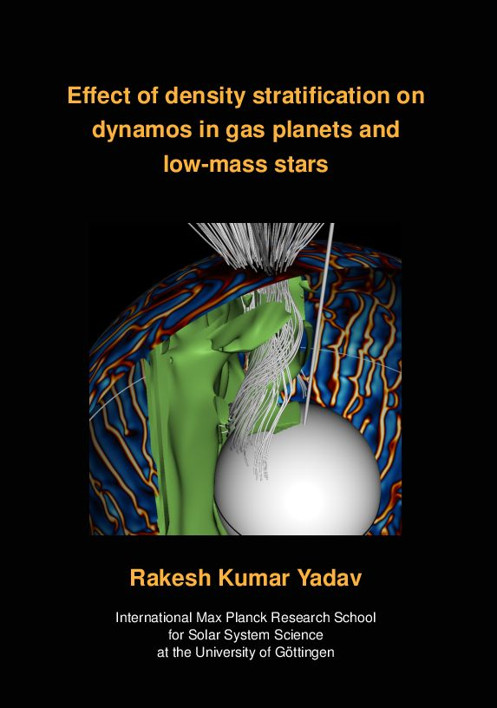
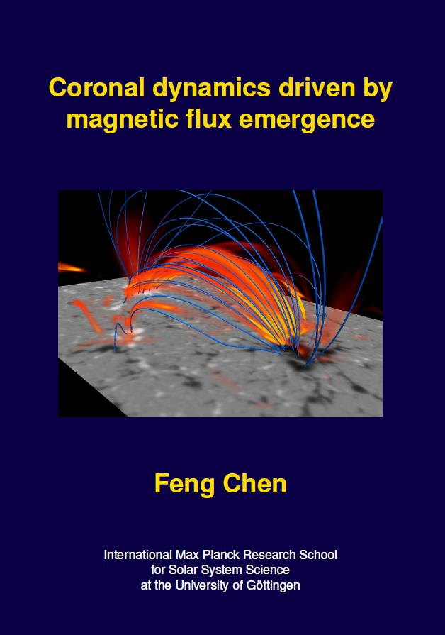
Sample covers of PhD theses

Slide 96
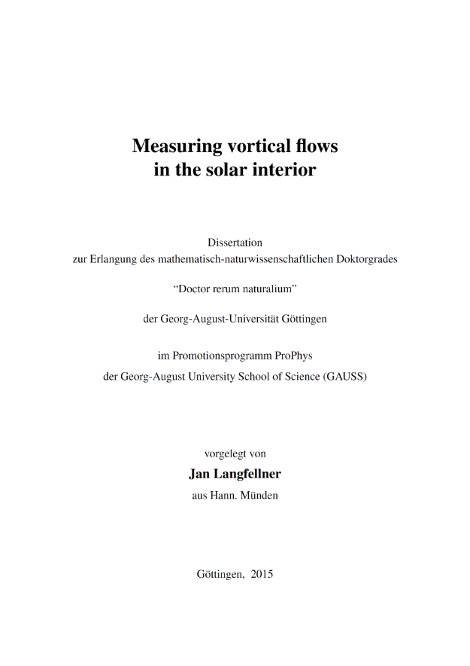

Title page etc.

Slide 97
Ph.D. Theses
In the IMPRS we expect each Ph.D. thesis to contain the material of multiple research papers
Remember that your thesis will be carefully read by multiple people and you will be questioned about it ➔ Don’t take writing your thesis too lightly ➔ Reserve enough time for writing !!!
Your marks can depend on how carefully you copy-edited your thesis (I know of outstanding students who missed getting a Summa for this very reason…)
A thesis MUST satisfy the requirements of the university! Otherwise it might be rejected
However, very few theses are read as often as research papers once the student has got his/her doctorate (although they are often given to new students starting on a subject as an introduction) ➔ Avoid unnecessary perfectionism

Slide 98
Ph.D. Theses
In the IMPRS we expect each Ph.D. thesis to contain the material of multiple research papers
Remember that your thesis will be carefully read by multiple people and you will be questioned about it ➔ Don’t take writing your thesis too lightly ➔ Reserve enough time for writing !!!
Your marks can depend on how carefully you copy-edited your thesis (I know of outstanding students who missed getting a Summa for this very reason…)
A thesis MUST satisfy the requirements of the university! Otherwise it might be rejected
However, very few theses are read as often as research papers once the student has got his/her doctorate (although they are often given to new students starting on a subject as an introduction) ➔ Avoid unnecessary perfectionism
Look at other recent PhD theses awarded at same
university in same field + talk with your supervisors, both at MPS and at university

Slide 99
Ph.D. Theses: Consistency
A thesis is book-length and contains multiple chapters
Often theses contain material from different papers (which may have been published in different journals), as well as chapters written specifically for the thesis (at least introduction plus conclusions)
When putting together the thesis from all these diverse sources it is important to make sure that they are all converted to a single style
  E.g. : either all references give titles of cited papers (capitalized or not), end page numbers etc., or none give them does
The layout and style, abbreviations, style of references, units etc. should be consistent throughout the thesis (unless it really is a compendium of publications, where e.g. units may be different)

Slide 100
Thank you for your attention

Slide 101
Acknowledgements
I am greatly indepted to the late Dieter Schmitt for help with sources and with the slides describing figures and tables
Robert Day’s book on “How to write and publish a scientific paper” is a rich source of material, both serious and not so serious. Many of the examples and some of the cartoons are borrowed from there
The lecture notes of Daniel Stotz on “Writing English for Science” at ETHZ was another great source of inspiration and material
The article “This is not an article” by Carsten Sørensen is witty and provided me with ideas and material
The same is true for the extensive and well-written guide by an unnamed author (or authors) at Bates College

Slide 102
Acknowledgements
I am deeply indebted to all the PhD students and post docs that I had or have the pleasure of supervising, including the not always pleasurable task of correcting their papers. They provided the incentive to prepare and give these lectures

