Slide 1

Chromospheric
Magnetograph
Andreas Lagg, Achim Gandorfer, Davina Innes
MPI for Solar System Research
Katlenburg-Lindau, Germany
lagg@mps.mpg.de

Slide 2
Motivation
Wishlist:
Provide reliable chromospheric magnetic field measurements
  Simple interpretation
  For all solar activity levels (QS → sunspot)
  spatial resolution TBD
  High temporal resolution
Reliable and „simple“ instrument
stand alone science

Slide 3
Candidates
He 10830 Å
Near-IR lines: He 10830 Å
Successfully used by ground based observatories (e.g. TIP-2, VTT)
Purely chromospheric
B-range 1 G to several kG
ideal for coupling science
height diagnostic tool!
off-limb AND on-disk ‘easy’ to interpret
(Asensio Ramos et al. 2008, Lagg et al., 2009)

Slide 4
He 10830 Å
VTT / TIP-2
Photosphere: Si 10827 Å

Slide 5
He 10830 Å
VTT / TIP-2
Chromosphere: He 10830 Å

Slide 6
He 10830: problems
IR – wavelength: need large aperture to achieve good spatial resolution
Formation: coronal illumination required
→ low sensitivity for QS regions
→ Well suited for large ground-based telescopes (Gregor, ATST, good IR seeing)
or large space-borne telescopes

Slide 7
Candidate:
Ca IR lines
Ca IR lines (8542 Å)
Complex non-LTE modeling required
Spatial resolution similar to He 10830
→ Leave it for ATST & Co

Slide 8
Candidate:
Na D / Mg Ib
Na I D₂ (5896 Å), Mg Ib (5173 Å)
Probe only upper photosphere / lower chromosphere
→

Slide 9
Candidate:
Ca II H&K
Ca II H (3933 Å), Ca II K (3968 Å)
Good lines for chromospheric diagnostic
Complex non-LTE analysis required
(chromospheric information „hidden“ in strong wings)

Slide 10
Candidate:
Mg II h&k
IRIS Science Summary:
“The Mg II resonance doublet lines have superior qualities over the visible chromospheric diagnostics. The Mg⁺ ion does not have a meta-stable upper state (as does Ca⁺ associated with its infrared triplet) which simplifies its radiative transfer; Mg⁺ is not significantly affected by excitation through absorption of coronal emission (unlike He 10830Å; except during major flares); and the range of formation for Mg II h&k is much narrower than for Hα. In effect, the Mg II h&k lines are formed under effectively thin conditions (emitted photons escape, albeit subject to scattering) while having a ~20-fold higher opacity (mostly because of the higher abundance). Consequently, the Mg II h&k lines have a much higher contrast – relative to the Ca II H&K doublet – for small structures higher in the atmosphere, while being revealing such small structures over a larger range in optical depth because the lines are effectively thin. In addition, we note that the broad wings of Mg II enable tracing of perturbations from the upper photosphere into the upper chromosphere.“

Slide 11
Mg II h&k
Heritage
Rocket & Balloon Experiments: e.g. Lemaire & Skumanich (1973), Morrill et al. (2001, HRTS flights 1975-1997), Samain & Lemaire (1982)
IRIS (Interface Region Imaging Spectrograph)
LMSAL, LMS&ES, SAO, ARC, MSU, LSJU, ITA/UiO
Solar-C Plan B
Modelling: Uitenbroek (1996), Boccialini (1996), Lemaire et al. (1981)

Slide 12
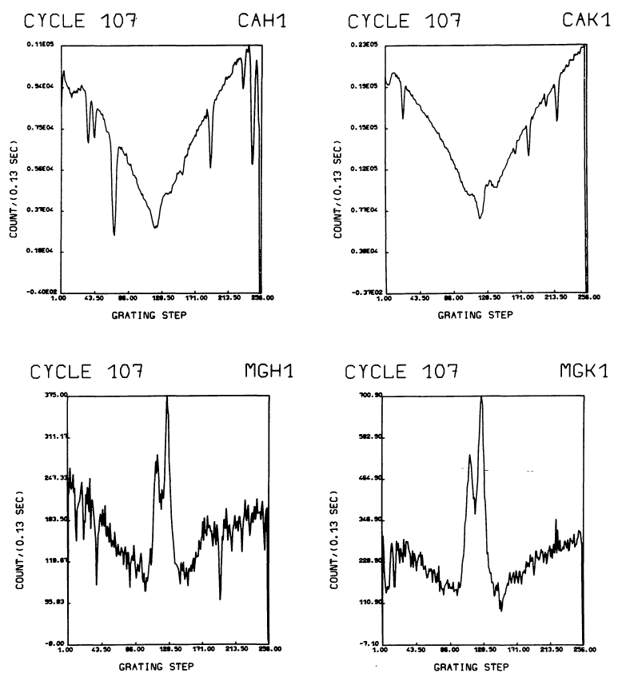
Mg II h&k spectra
Quiet Sun
LPSP instrument on OSO-8
Lemaire et al. (1981)

Slide 13
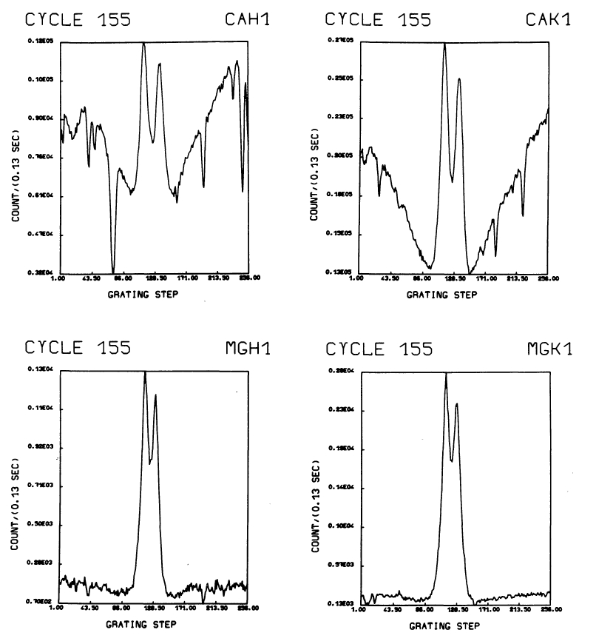
Mg II h&k spectra
Plage
LPSP instrument on OSO-8
Lemaire et al. (1981)

Slide 14
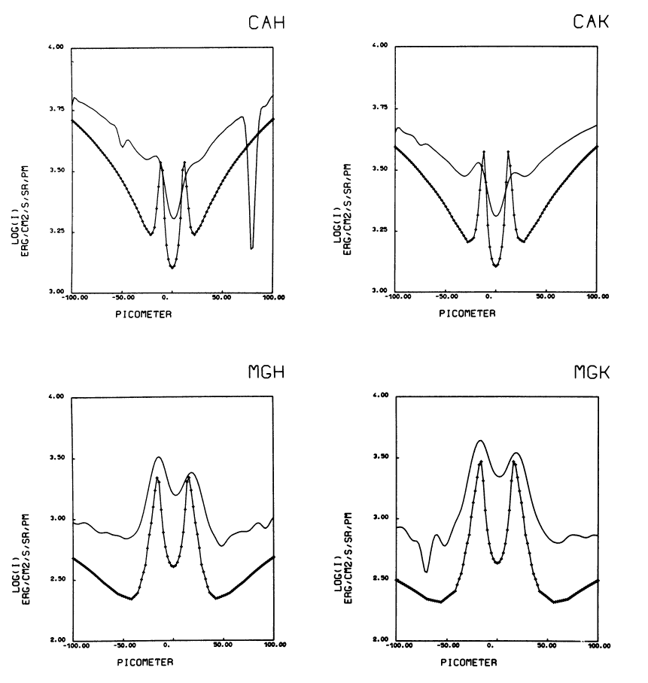
Mg II h&k spectra
Plage – Flux Levels
3500
LPSP instrument on OSO-8
Lemaire et al. (1981)
1800
4000
550

Slide 15
Mg II h&k
Instrument
Full Stokes Imaging Polarimeter
Lyot Prefilter and one or two etalons
Optics/CCD: no showstoppers for 280 nm range
Size? (30cm aperture = 0.235´´ diff. limit resolution)
Diffraction limited performance (yes/no?) with option to increase S/N by on-board binning
FOV: ~240´´ (2K detector)

Slide 16
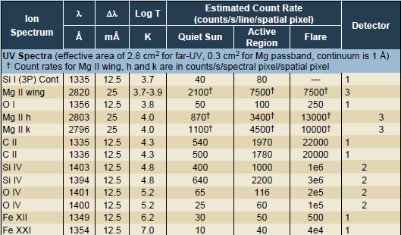
Mg II h&k photon budget
IRIS instrument (diff. limited):

Slide 17
Mg II h&k noise level
Mg II K | Quiet Sun | Active Region | Flare
Intensity (counts/s/spectral pixel/spatial pixel) 25 mÅ spectral pixel | 1100 | 4500 | 10000
Polarimeter (33% eff.) 5s integration time (counts/spectral pixel/spatial pixel) 40 mÅ spectral pixel | 2900 | 12000 | 26500
Polarimetric accuracy (noise level) for Q, U, V diff. limited | 1.85% | 0.92% | 0.62%
Polarimetric accuracy (noise level) for Q, U, V 3x diff. limit | 0.62% | 0.3% | 0.2%

Slide 18
Summary
Mg II h&k imaging polarimeter
``ideal´´ chromospheric magnetograph
new stand-alone
support science for coronal measurements
photospheric channel?
theoretical modelling: A. Pietarila

